Slide 1

Undergraduate Project
(Sem-VI)
Neural Style Transfer
Supervisor : Dr. Rajeev
Presented by: Siddharth Gautam (22124043)
Dept. of Mathematical Sciences

Slide 2
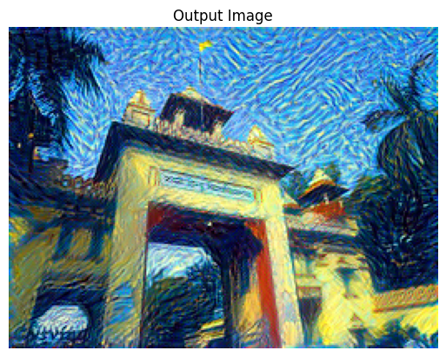

What is Neural Style Transfer?
Neural style transfer is an innovative technique in the realm of deep learning that allows for the combination of the content of one image with the artistic style of another.
Popularized by the groundbreaking work of Gatys et al. in 2015, this method utilizes convolutional neural networks (CNNs) to separate the content and style elements within an image, enabling the synthesis of a new image that retains the structure and content of the first image while adopting the visual style of the second.
For example, it can take a photograph and apply the painting style of Van Gogh, transforming the photo into a piece of art that mimics the brushstrokes, colors, and textures characteristic of the painter.

Slide 3
What is Neural Style Transfer?
The underlying technique involves using pre-trained CNNs, like the VGG-19 network, to extract hierarchical features from both the content and style images.
The content image is analyzed to capture the high-level semantic information, such as objects and their arrangement, while the style image is analyzed to extract low-level patterns, such as textures, color distributions, and brushstroke patterns.
These features are then compared using a loss function that balances the content loss (which ensures that the output image remains faithful to the original content) and the style loss (which ensures that the output resembles the style image in terms of texture and patterns).
Through iterative optimization, the algorithm adjusts a randomly initialized image to minimize these losses, resulting in a final image that blends the content of one image with the artistic style of another.
This method is not limited to static images—recent advancements in neural style transfer have enabled real-time applications for video processing, allowing dynamic scenes to adopt artistic styles frame by frame. Neural style transfer has thus found applications across a wide range of fields, from digital art creation and graphic design to data augmentation and image synthesis, offering unprecedented creative freedom in visual content creation.

Slide 4
What is a CNN?
CNNs are a class of deep learning algorithms specifically designed for processing and analyzing visual data.
Layers: A CNN typically consists of several types of layers:
Convolutional Layers: These layers apply filters (kernels) to the input image to detect features like edges, textures, and patterns.
Pooling Layers: These layers downsample the image, reducing its dimensions and computational complexity while retaining important features.
Fully Connected Layers: These layers connect all the neurons and make final predictions or classifications based on the extracted features.
Feature Extraction: CNNs automatically learn spatial hierarchies of features from the data. Early layers detect simple features (e.g., edges), while deeper layers capture more complex patterns (e.g., shapes, objects).
Training: CNNs are trained using backpropagation and gradient descent to minimize a loss function, allowing the model to learn the optimal weights for accurate predictions.
Applications: CNNs are widely used in image classification, object detection, facial recognition, medical imaging, and autonomous vehicles.

Slide 5
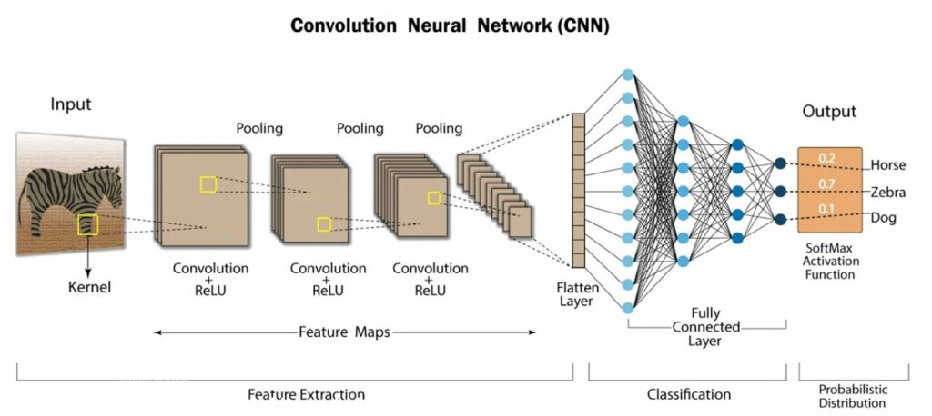
What is a CNN?

Slide 6
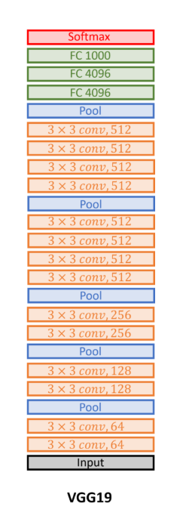
VGG-19 Architecture Overview
1
16 Convolutional Layers
Extract features using 3x3 filters.
2
Max-Pooling Layers
Reduce dimensions after convolutional layers.
3
3 Fully Connected Layers
Interpret extracted features for classification.
VGG-19 consists of 16 convolutional layers and 3 fully connected layers. It uses 3x3 filters and max-pooling for efficient feature extraction. This architecture is known for its simplicity and effectiveness in image classification tasks.

Slide 7
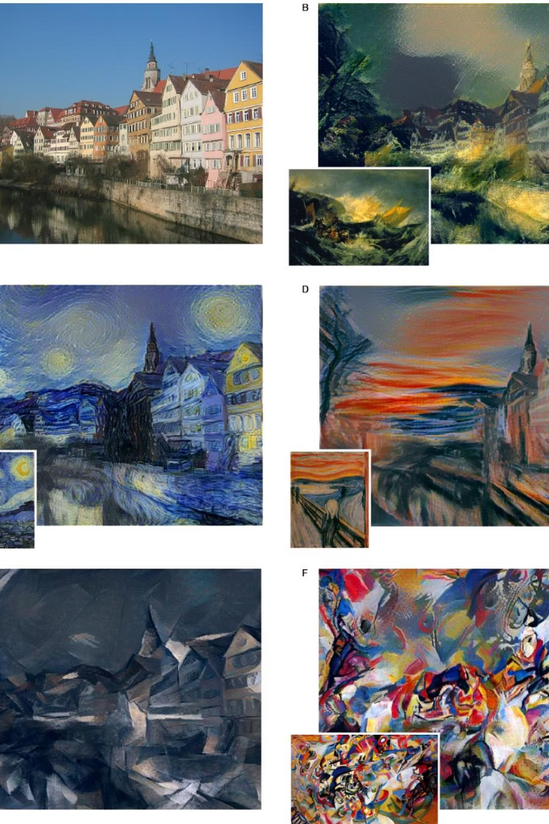
Methodology
Input: Content image (structure) + Style image (artistic influence)
Objective: Generate a new image that combines content of one with style of another
Feature Extraction: Use a pre-trained CNN (e.g., VGG19) to extract features from all three images
Content Representation: Extract higher-layer activations to capture image structure
Style Representation: Compute Gram matrices of lower-layer activations to capture texture and patterns
Loss Functions:
Content Loss: Difference between content and generated image features
Style Loss: Difference between style and generated image Gram matrices
Optimization:
Start with a copy of the content image or white noise
Minimize total loss (content + style) using gradient descent (e.g., L-BFGS or Adam)
Output: Stylized image with content preserved and artistic style transferred

Slide 8
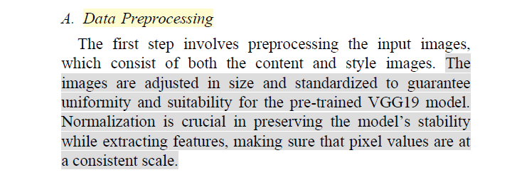

Slide 9
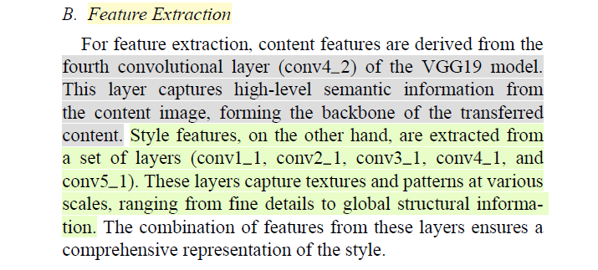

Slide 10
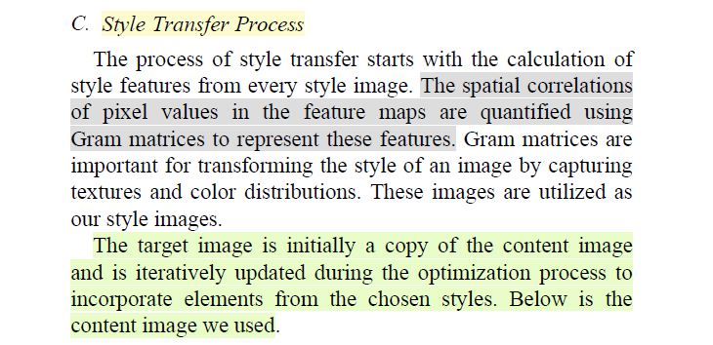

Slide 11
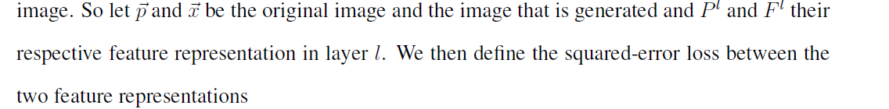
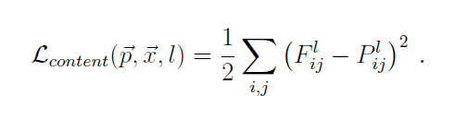

Slide 12
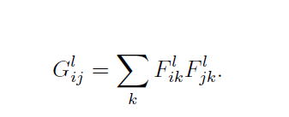
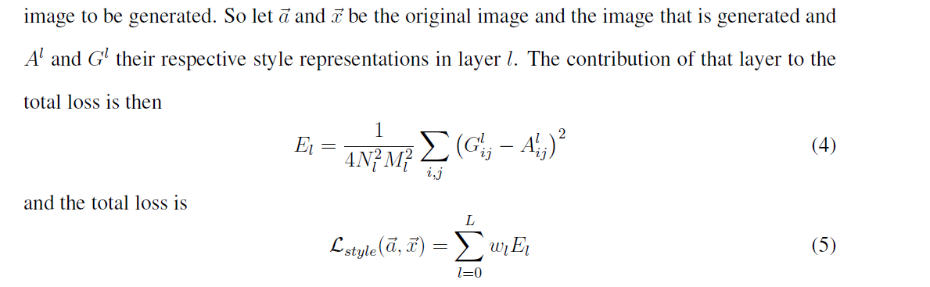

Slide 13
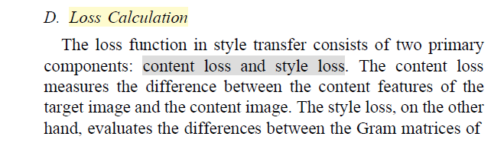
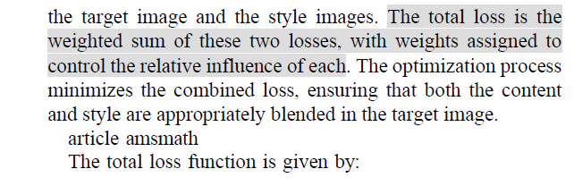
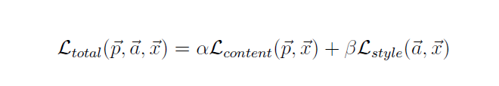

Slide 14
Hyperparameters
Content weight (α): Set to 1, ensuring the structural integrity of the content image is preserved.
Style weight (β): Set to 1e9, significantly higher to emphasize stylistic features.
Style layer weights :
conv1_1: 1.0
conv2_1: 0.75
conv3_1: 0.2
conv4_1: 0.2
conv5_1: 0.2
Learning rate: 0.003, controlling the optimization step size.
Number of iterations: 2000 steps to ensure convergence.
Intermediate visualization: Results displayed every 400 steps.
Activation function: ReLU => f(x)=max⁡(0,x) , introduces non-linearity and mitigates vanishing gradients.

Slide 15
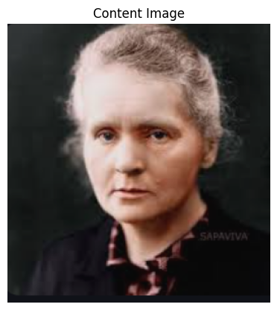
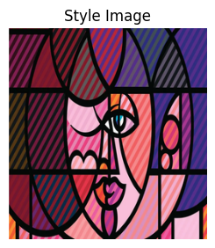
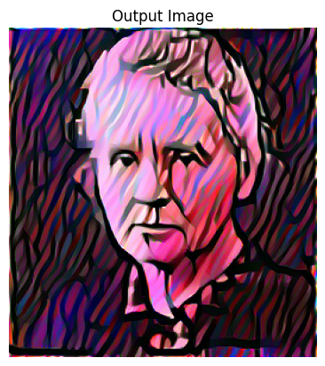
Results: Style Transfer

Slide 16
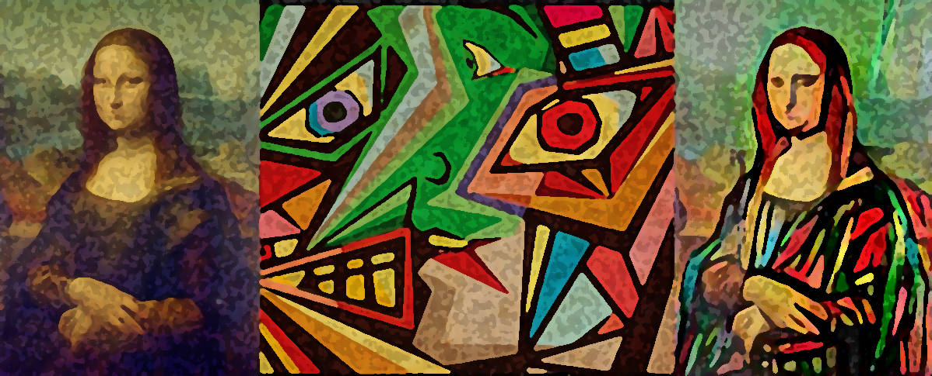
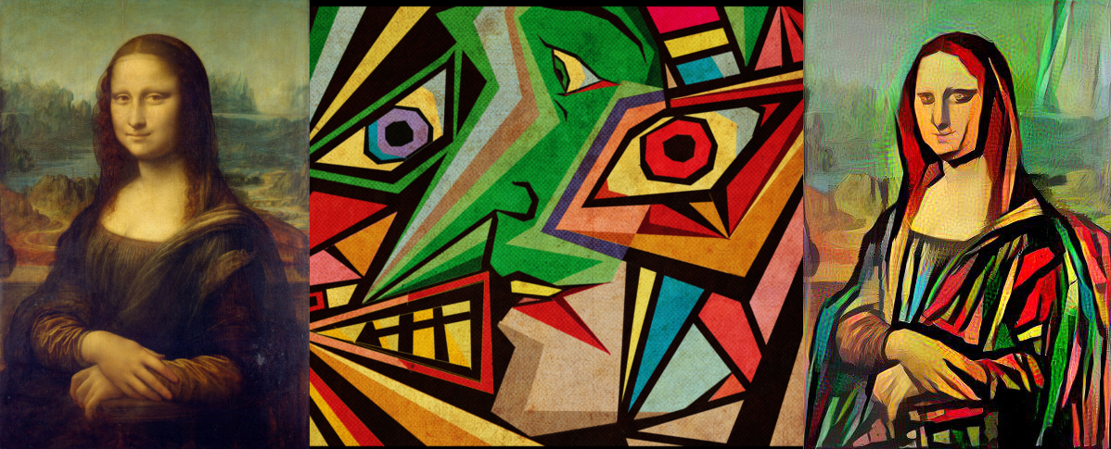
Results: Style Transfer
Output Image
Content Image
Style Image

Slide 17
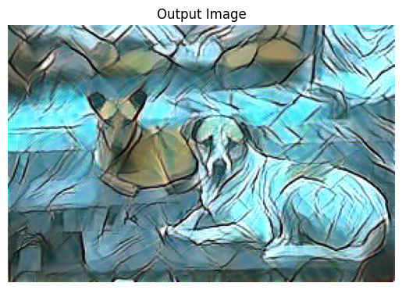
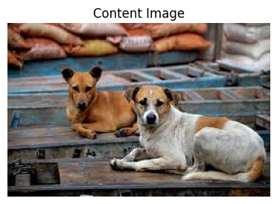
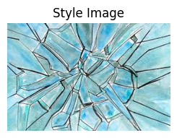
Results: Style Transfer

Slide 18
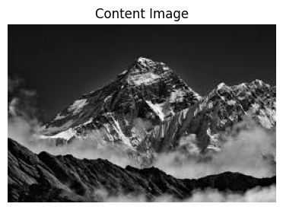
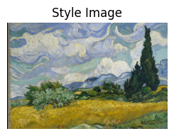
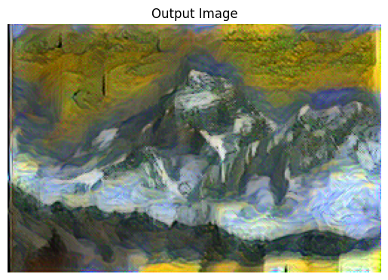
Results: Style Transfer

Slide 19
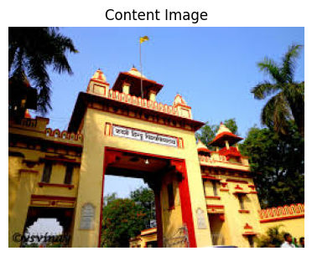
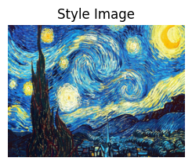
Results: Style Transfer

Slide 20
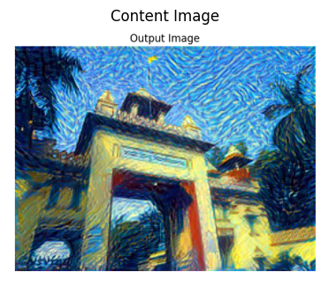
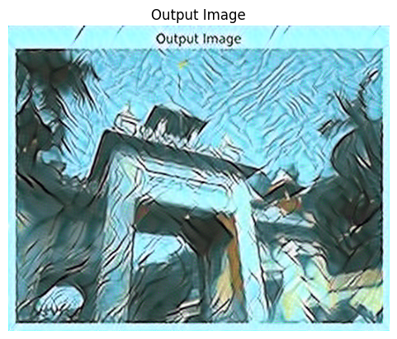
Results: Multi Style Transfer

Slide 21
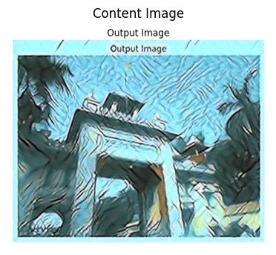
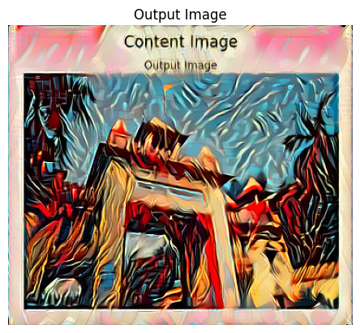
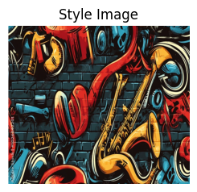
Results: Multi Style Transfer

Slide 22
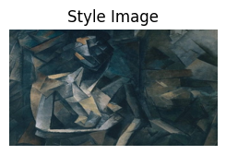
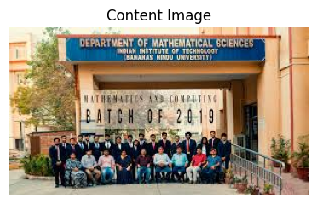
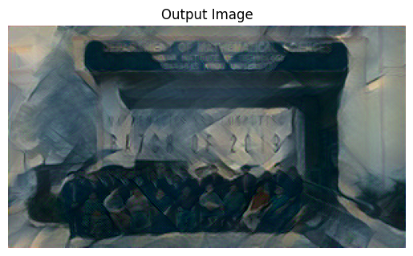
Results: Limitations
If the image contains too much textual details, the result is not very effective

Slide 23
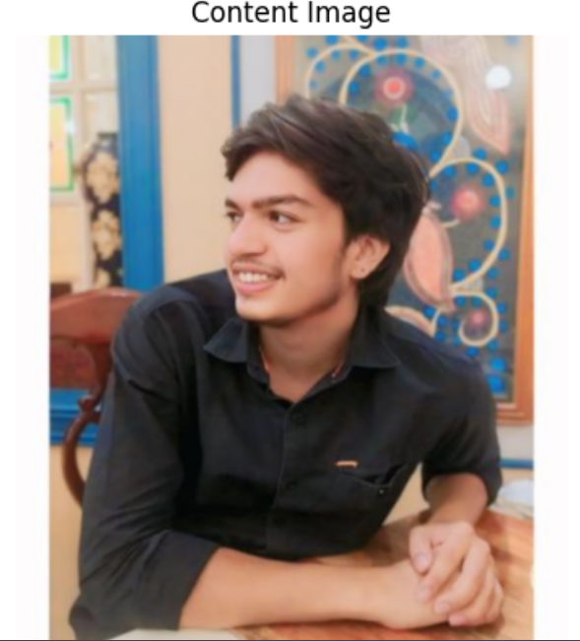
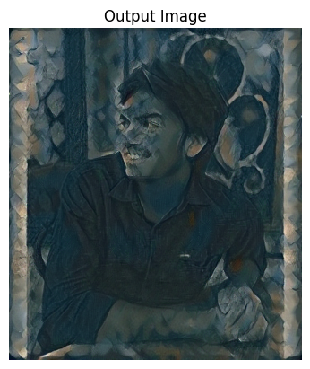
Results: Limitations
Some styles are not very suitable for input images

Slide 24
Link to the Code on Google Collab :
https://colab.research.google.com/drive/1CZRthjtEYio6kze13znV39oLvrPP3dfD

Slide 25
Applications of NST
1
Augmented Reality (AR)
2
Photo Filters
Apply artistic styles in real-time to the world via AR apps
Create advanced filters for creative effects, enhancing photos with various artistic styles.
3
Video Style Transfer
4
Advertising
Apply consistent artistic styles across video frames, creating visually stunning videos.
Generate unique images for ads and branding, capturing attention and conveying brand identity.
5
Fashion Design
6
Game Development
Generate new patterns and designs for clothing, staying ahead of trends.
Create unique textures and environments for games, enhancing the gaming experience.

Slide 26
Key References & Acknowledgments
1. Kashyap, K., Fargose, S., Garg, M., & Nair, S. (2025). Dynamic Neural Style Transfer for Artistic Image Generation using VGG19. arXiv preprint arXiv:2501.09420. https://arxiv.org/abs/2501.09420 This paper introduces a neural style transfer system utilizing the VGG19 model for feature extraction, enabling high-quality, flexible stylization without compromising content integrity
2. Gatys, L. A., Ecker, A. S., & Bethge, M. (2015). A Neural Algorithm of Artistic Style. arXiv preprint arXiv:1508.06576. https://arxiv.org/abs/1508.06576 This seminal work presents a neural algorithm that separates and recombines content and style of arbitrary images, laying the foundation for neural style transfer techniques.

